Slide 1
Too Many chefs in the kitchen An argument in favor of program execution models
erhtjhtyhy
Jose M Monsalve Diaz
Postdoctoral Researcher
Argonne National Laboratory
Mathematics and Computer Science Division
jmonsalvediaz@anl.gov
Saturday February 25th 2023
Montreal, Canada
BID Workshop at PPoPP 2023

Slide 2
Outline
Too many chefs in the kitchen
PART1: ”Those Who Do Not Learn History Are Doomed To Repeat It”
PART 2: Parallel Runtime Systems
PART 3: Program Execution Models
PART 4: The Codelet Mode

Slide 3
Part 1:
”Those Who Do Not Learn History Are Doomed To Repeat It”

Slide 4
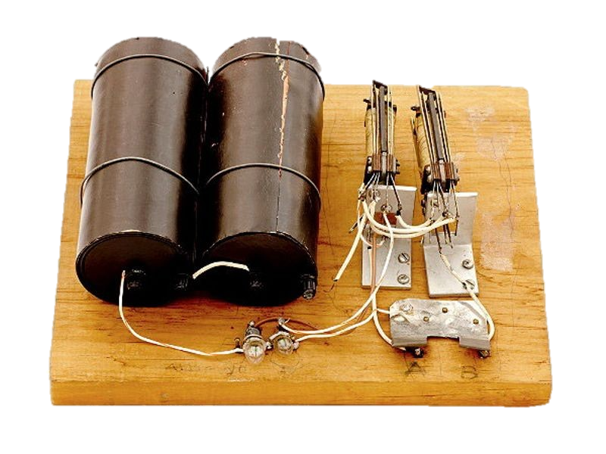
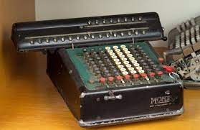
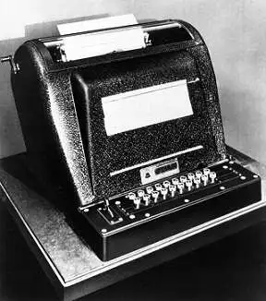
Pre-computers
1930’s Model K Adder
Mechanical and electrical calculators
The first element to be created was an ALU
1 bit adder
1910’s Monroe Calculating Machine
1940’s Complex Number Calculator
Images from http://infolab.stanford.edu/pub/voy/museum/pictures/display/1-Calculators.htm and https://www.computerhistory.org/timeline/computers/

Slide 5
Pre-computers
Programming and Scheduler
Arithmetic Logic Unit
Programmer and
Scheduling of Instructions
Image from https://www.computerhistory.org/timeline/computers/

Slide 6
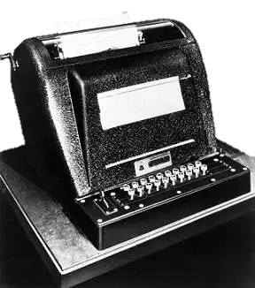
First Human “computers”
A desk view
(3+4)*25

Slide 7
First Human “computers”
Load 3
(3+4)*25
3

Slide 8
First Human “computers”
Read operation +
(3+4)*25
+

Slide 9
First Human “computers”
Load 4
(3+4)*25
4

Slide 10
First Human “computers”
Store the result
(3+4)*25
7
7

Slide 11
First Human “computers”
Load Operation ”times”
(3+4)*25
7
*

Slide 12
First Human “computers”
Load 25
(3+4)*25
7
*

Slide 13
First Human “computers”
Store the result
(3+4)*25
7
175
175

Slide 14
First Human “computers”
Parts of a sequential computer
(3+4)*25
7
Program
175
ALU + Regs
Memory
Fetch, Decode, Schedule

Slide 15
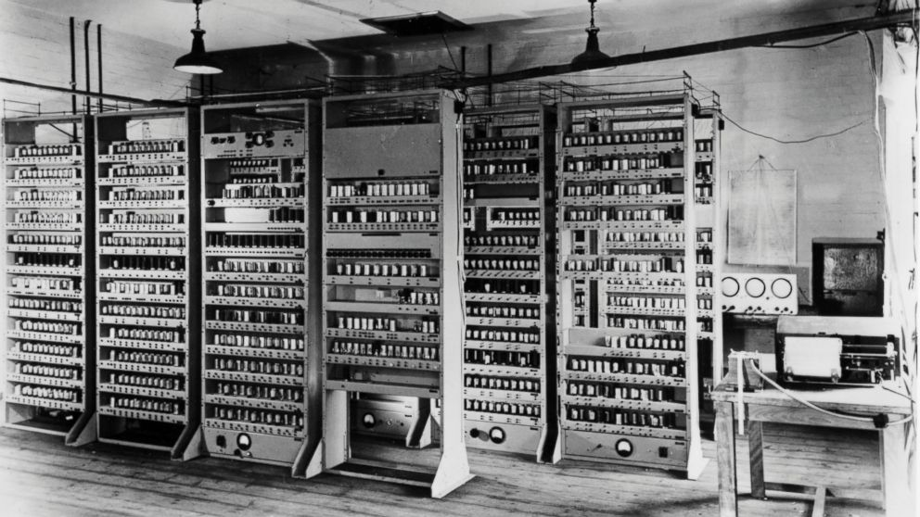
FETCH
DECODE
ALU
CLK
IO
Reg
MEM CTRL
Reg
MEM CTRL
EDSAC 1949

Slide 16
Learning #1:
Computers always require an Scheduler mechanism around the compute units (ALU)

Slide 17
Instruction Set Architecture
17
divided SW/HW evolution
Intel Tejas (Cancelled)
Intel 80386
IBM PC
Intel 8086
Writable Control Store
Von Neumann Architecture
CDC6600
Hardware
FORTRAN
Turing Machine
Short Code
ISA (IBM 360)
1979
1981
1985
2004
1966
1973
Large distance between hardware and software abstractions
Unix
POSIX Threads
1936
1945
1949
1957
1960
OpenMP 1.0
C
AIX OS
C++
MPI 1
Software
1969
1972

Slide 18
OS Isolation and runtime
All processes are owners of the whole system
Dev
MEM
CPU
MEM
CPU
MEM
CPU
Von Neuman
Machine Abstraction
Process
Process
Process
OS RUNTIME AND ISOLATION
MEM
CPU
I/O
Real Hardware

Slide 19
Learning #2:
Instruction Set Architectures standardized programs for a large collection of machines. (Portability)

Slide 20
Learning #3:
OS Runtime does not change the machine abstraction, but rather orchestrates the execution of processes that respect the machine abstraction (and its execution model)

Slide 21
Part 2:
Parallel runtime Systems

Slide 22
Abstract Machines
What is it?
Describes the basic components of the system and their connection without specifics of the implementation of the actual system
Examples:
A table has a table top and some number of legs
A soccer field is a delimited area that has 2 goal arcs opposed to each other
Von Neumann: A computer has memory, a sequential CPU, and I/O

Slide 23
Runtimes implement Abstract machines
OpenMP runtime example
Runtime View
#requires unified shared memory
Unified shared memory
Real System Hardware
Host Memory
Device Memory
Core
Core
Core
Core
GPU SM
GPU SM

Slide 24
Runtimes implement Abstract machines
OpenMP runtime example
Runtime View
#requires unified shared memory
#pragma omp parallel sections
#pragma omp section
#pragma omp parallel num_threads(2)
#pragma omp single
for (...)
#pragma omp task
//...
Unified shared memory
Section 1
TaskQ
Sched
Thrd
Thrd
Real System Hardware
Host Memory
Device Memory
Core
Core
Core
Core
GPU SM
GPU SM

Slide 25
Runtimes implement Abstract machines
OpenMP runtime example
Runtime View
#requires unified shared memory
#pragma omp parallel sections
#pragma omp section
#pragma omp parallel num_threads(2)
#pragma omp single
for (...)
#pragma omp task
//...
#pragma omp section
#pragma omp parallel num_threads(4)
Unified shared memory
Section 1
Section 2
TaskQ
Sched
Thrd
Thrd
Thrd
Thrd
Thrd
Thrd
Real System Hardware
Host Memory
Device Memory
Core
Core
Core
Core
GPU SM
GPU SM

Slide 26
Runtimes implement Abstract machines
OpenMP runtime example
Runtime View
#requires unified shared memory
#pragma omp parallel sections
#pragma omp section
#pragma omp parallel num_threads(2)
#pragma omp single
for (...)
#pragma omp task
//...
#pragma omp section
#pragma omp parallel num_threads(4)
#pragma omp section
#pragma omp target teams num_teams(3)
Unified shared memory
Section 1
Section 2
Section 3
TaskQ
DeviceQ
Sched
Sched
Thrd
Thrd
Device
Team
Team
Thrd
Thrd
Thrd
Thrd
Real System Hardware
Host Memory
Device Memory
Core
Core
Core
Core
GPU SM
GPU SM

Slide 27
Runtimes implement Abstract machines
OpenMP runtime example
Runtime View
Unified shared memory
Section 1
Section 2
Section 3
TaskQ
DeviceQ
Sched
Sched
Thrd
Thrd
Runtime emulates the behavior of the machine abstraction
Device
Team
Team
Thrd
Thrd
Thrd
Thrd
Real System Hardware
Host Memory
Device Memory
Core
Core
Core
Core
GPU SM
GPU SM

Slide 28
Abstract Machine Collision of Runtimes
Too many chefs in the kitchen
Library 1
Large software
OpenMP RT
Dev
OpenMP Runtime
Library 2
Raja RT
Library 4
Library 4
Library 3
OmpSs RT
Legion RT
Kokkos RT

Slide 29
Interoperability of runtimes
It’s not a bug… it’s a feature

Slide 30
Learning #4:
Multiple runtimes implement Different abstract machines, assuming full ownership of the system. Then, Their mechanisms collide with each other.

Slide 31
Software Modularity Principles
Jack Dennis – “A Parallel Program Execution Model Supporting Modular Software Construction”
Information Hiding
Invariant Behavior
Data Generality
Secure Arguments
Recursive Construction
System Resource Management
Notes:
1. Information Hiding Principle: The user of a module must not need to know anything about the internal mechanism of the module to make effective use of it.
2. Invariant Behavior Principle: The functional behavior of a module must be independent of the site or context from which it is invoked.
3. Data Generality Principle: The interface to a module must be capable of passing any data object an application may require.
4. Secure Arguments Principle: The interface to a module must not allow side-effects on arguments supplied to the interface.
5. Recursive Construction Principle: A program constructed from modules must be usable as a component in building larger programs or modules.
6. System Resource Management Principle: Resource manage- ment for program modules must be performed by the com- puter system and not by individual program modules.

Slide 32
Learning #4.1:
Current Runtime systems break principles of software modularity

Slide 33
Part 3:
Program Execution Models

Slide 34
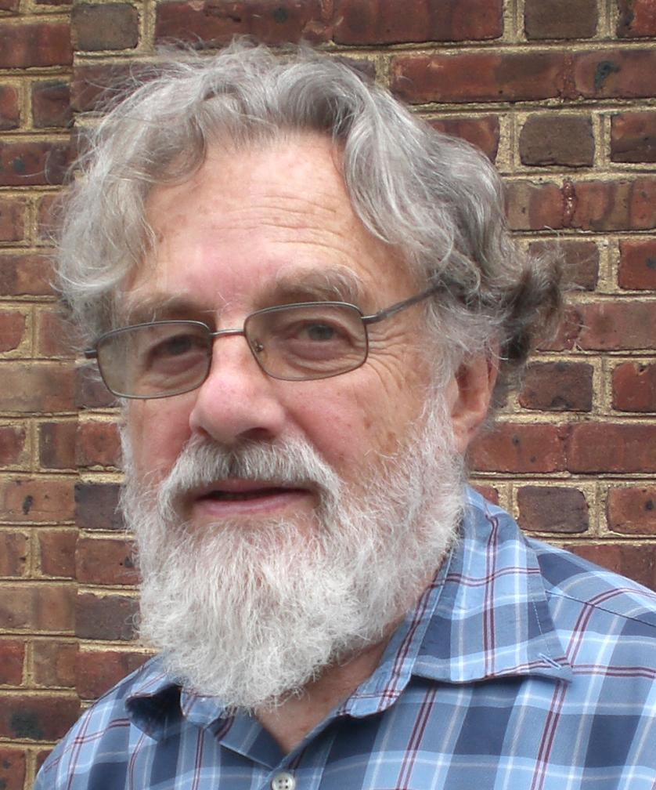
Definitions of Program Execution Model (PXM)
Jack Dennis: “A program execution model (PXM) is a specification of computer system behavior in execution of programs.”
Guang Gao:
“The program execution model (PXM) is the basic low-level abstraction of the underlying system architecture upon which our programming model, compilation strategy, runtime system, and other software components are developed.

Slide 35
Program Execution Model
Why is this important?
It is not implemented by a runtime,
It is the underlying truth of all the actors in the system.
Architecture, compiler, OS, libraries and developers.
Unique Machine Abstraction across all the actors in the system
Definition of machine semantics are independent of the syntax of a given programming model or its compilation infrastructure.
It is independent of programming models
Unique description of program components:
Scheduling instructions
Compute instructions
Memory instructions

Slide 36
OS Isolation and runtime
All processes are owners of the whole system
Dev
MEM
CPU
MEM
CPU
MEM
CPU
Von Neuman
Machine Abstraction
Process
Process
Process
OS RUNTIME AND ISOLATION
MEM
CPU
I/O
Real Hardware

Slide 37
Research Question:
What is an appropriate program execution model, that respects principles of modularity, and can be used for parallel, extremely heterogenous and distributed systems?

Slide 38
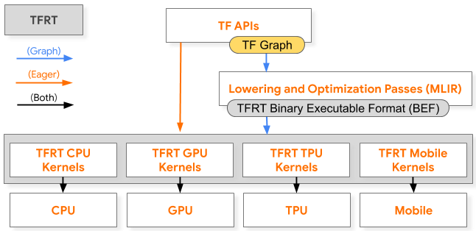
Success case 1
AI/ML frameworks
A single representation – Many implementations
Decouple
Description of
computation
From
Execution and hardware architecture

Slide 39
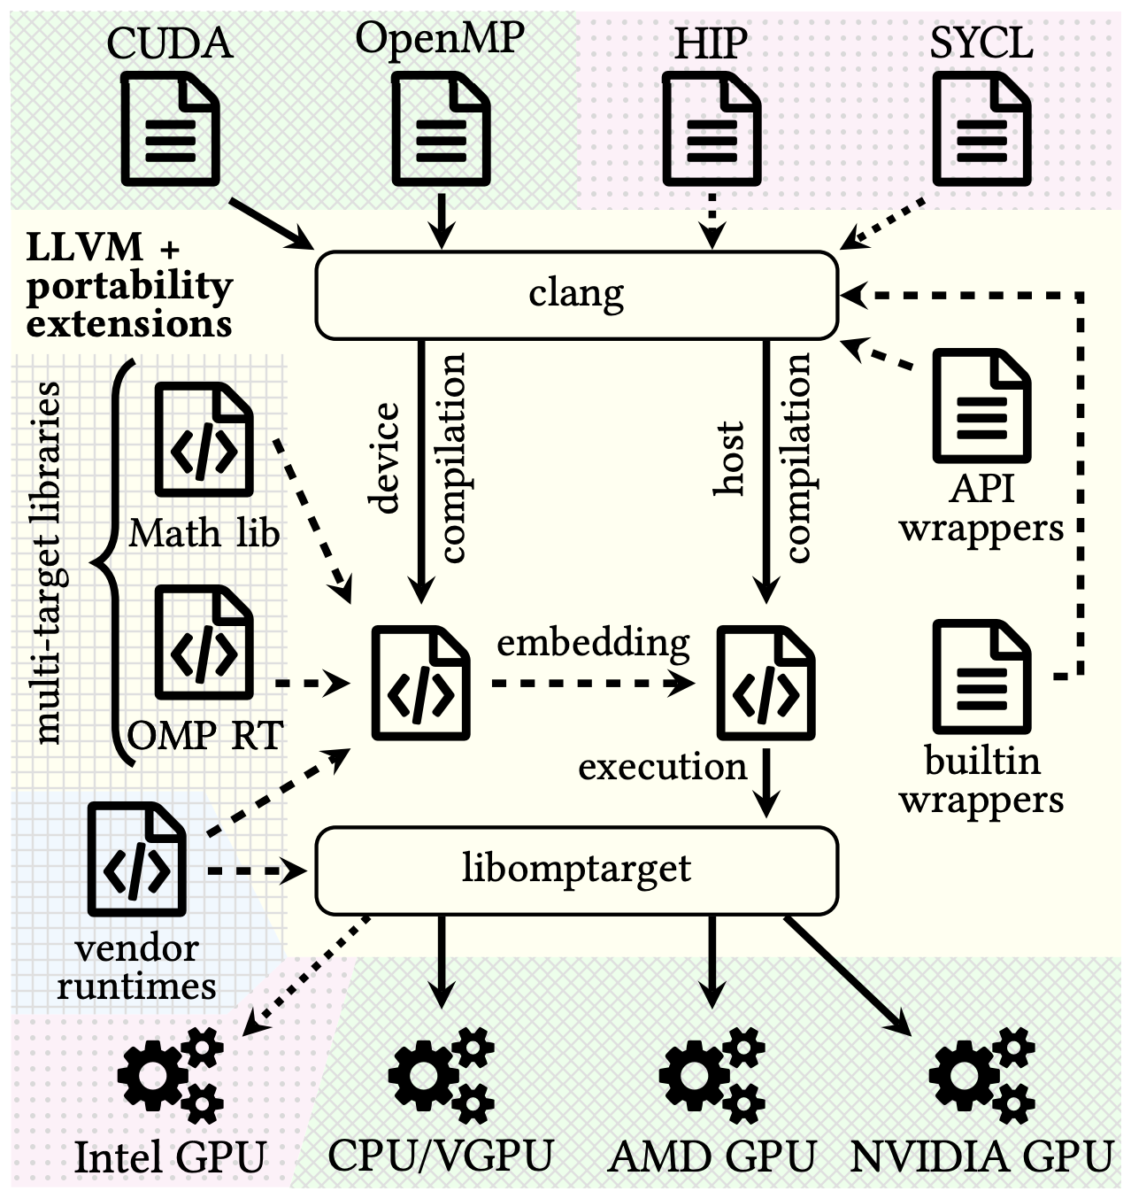
Success case 2
Johannes Doerfert – Breaking the Vendor Lock
A single runtime to rule them all

Slide 40
Learning #5:
We need a universal program execution model that decouples application semantic from machine abstraction and program execution

Slide 41
Part 4:
The Codelet Model

Slide 42
What is a Codelet
Yet another word for task … Not quite
It is a Data Flow actor
Describe as a pure function
Output only depends on the inputs
No saved state between executions
Atomically scheduled
x
y
z = f(x,y)
z

Slide 43
What is a Codelet
Yet another word for task … Not quite
Analogy:
An arithmetic instruction of a traditional Instruction Set Architecture
x
y
z = f(x,y)
z

Slide 44
Sequential Codelet Model
Express the Codelet graph sequentially
Similar to an ISA:
LD R1 ADDR1
LD R2 ADDR2
OP1 R3 R1 R2
OP2 R3 R4
OP2 R3 R5
OP3 R3 R6
OP3 R3 R7
LD
LD
OP1
OP2
OP2
OP3
OP3

Slide 45
Sequential CODELET Model
2 Levels Abstract Machine
Scheduling Unit
L0 Register File
Memory Access Interface
Write Back
SYNC
FETCH
DECODE
L0
ALU + FP
Commodity single core architectures
(x86, ARM, RISC-V)
L0 Inst Mem

Slide 46
Sequential CODELET Model
Scheduling Unit
L1 Register File
L0 memory
Memory Access Interface
Write Back
SYNC
FETCH
DECODE
2 Levels Abstract Machine
L1
CODELET EXECUTION UNIT
(e.g. x86 Core)
Codelet Level
L1 Inst Mem
Scheduling Unit
L0 Register File
Memory Access Interface
Write Back
SYNC
FETCH
DECODE
L0
ALU + FP
Commodity single core architectures
(x86, ARM, RISC-V)
L0 Inst Mem

Slide 47
Sequential Codelet Model
3 type of instructions
Compute Codelets
Memory Codelets
Control flow instructions

Slide 48
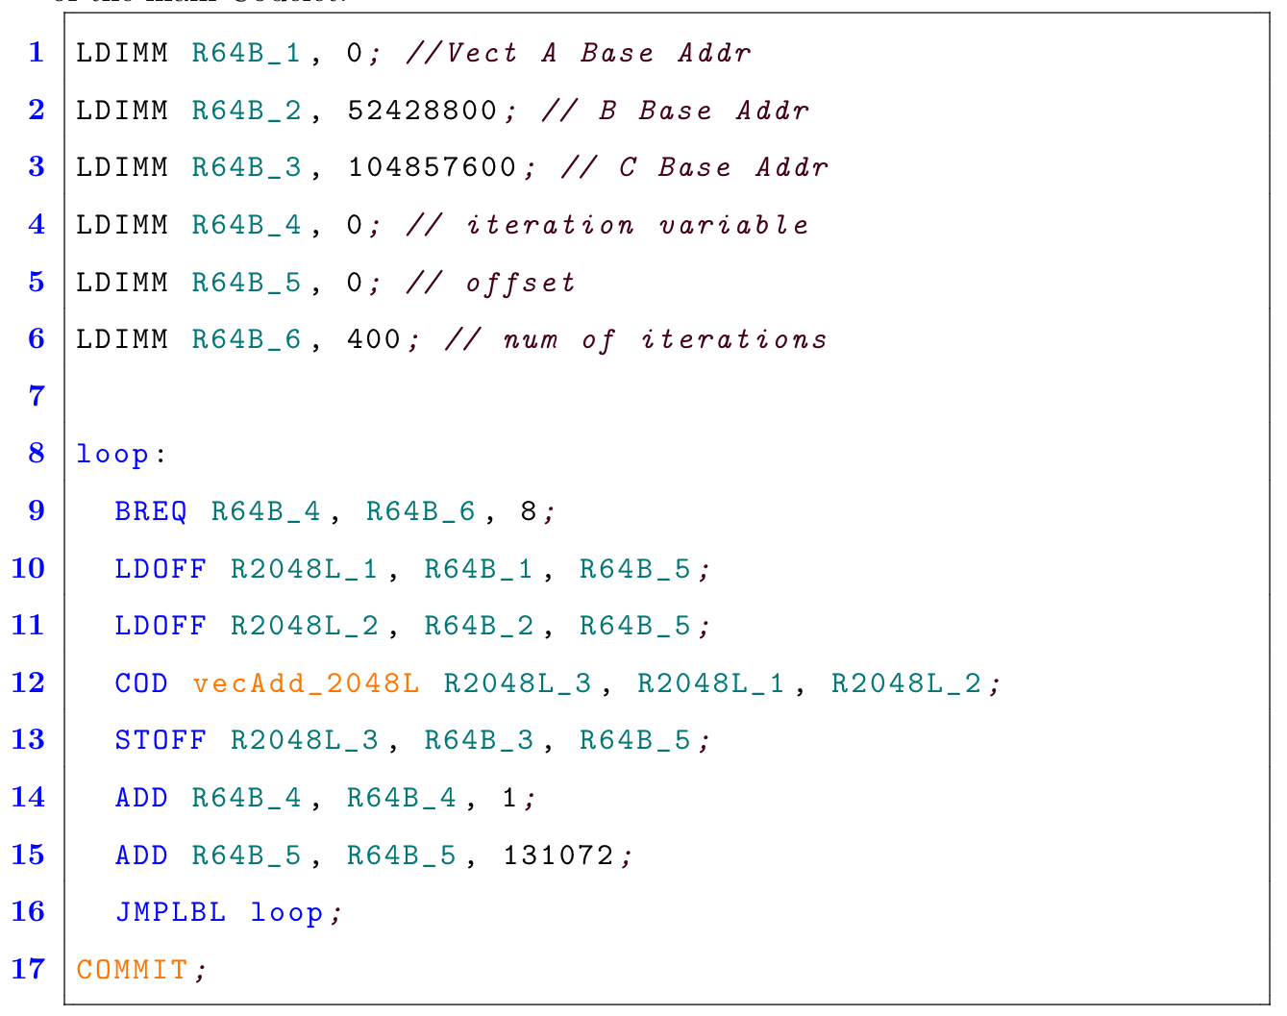
Vector Addition

Slide 49
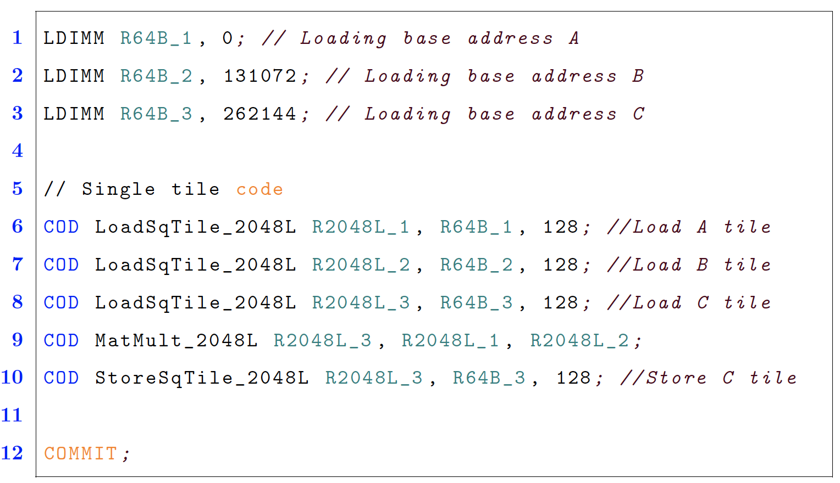
Matrix Multiplication
128
TILE
128

Slide 50
On Memory Codelets
Prefetching, Recoding, Moving and Streaming Data
Fox, Monsalve Diaz, and Li - Preprint
DRAM
MEMORY
Scheduling Unit
L1 Register File
L0 memory
Memory Codelet Unit
Write Back
SYNC
CODELET EXECUTION UNIT
(e.g. x86 Core)
CODELET EXECUTION UNIT
(e.g. x86 Core)
CODELET EXECUTION UNIT
(e.g. x86 Core)
L1 Inst Mem

Slide 51
Chiplets and The Codelet Model
Fox, Monsalve Diaz, and Li - Preprint
DRAM
MEMORY
CPU-based Chiplet
GPU-based Chiplet
Codelet PXM Chiplet
Mem
L2 Registers
Mem
L2 Registers
Mem
L2 Registers
Interconnect
Memory and Recode Chiplet
DoE accelerators chiplet
Other chiplet
Mem
L2 Registers
Mem
L2 Registers
Mem
L2 Registers

Slide 52
Thanks!
Jose M Monsalve Diaz
Postdoctoral Researcher
Argonne National Laboratory
Mathematics and Computer Science Division
jmonsalvediaz@anl.gov
Summary slide
Computers always require an Scheduler mechanism around the compute units (ALU)
Instruction Set Architectures standardized programs for a large collection of machines. (Portability)
OS Runtime does not change the machine abstraction, but rather orchestrates the execution of processes that respect the machine abstraction (and its execution model)
Multiple runtimes implement Different abstract machines, assuming full ownership of the system. Then, Their mechanisms collide with each other.
Current Runtime systems break principles of software modularity
We need a universal program execution model that decouples application semantic from machine abstraction and program execution

Slide 53
Backup Slides

Slide 54
Dataflow view
Control flow instructions define dataflow graphs
3
4
c = 2; a =4; b=5;
if (a > 10)
b = (a + b)*c;
else
c = a + a;
a = b + c;
c = 2; a =4; b=5;
if (a > 10)
+
25
b = (a + b)*c;
c = a + a;
X
b = (a + b)*c;

Slide 55
Dataflow view
c = 2; a =4; b=5;
if (a > 10)
Control flow instructions
define dataflow graphs
3
4
c = 2; a =4; b=5;
if (a > 10)
b = (a + b)*c;
else
c = a + a;
a = b + c;
+
b = (a + b)*c;
c = a + a;
25
X
b = a+c;

Slide 56
Outline
”Those Who Do Not Learn History Are Doomed To Repeat It”
Pre-computers -> Creation of ALU
First computers -> Collection of components, no ISA
Introduction of ISA -> A single one to rule them all
The sequential abstractions
Process == A virtual version of the real machine
OS runtime == Guarantee that all processes believe they are owners of the machine, but the machine abstraction is kept
Runtimes are emulated machines
An example of the OpenMP runtime system
A program Execution Model supporting software modularity
Principles by Dennis
Current programming solutions break software modularity
Interoperation == How to connect machine abstractions
A simple example. Using multiple runtimes with MM.
Big idea: A Program Execution Model:
What is a Program Execution Model
Why is this necessary?
Two successful directions examples:
AI and ML. Representation of compute graphs. But application specific…
Breaking the vendor lock. Single API runtime. But still living in the system space
Codelet Model and Sequential Codelet Model
The machine abstraction
Examples of execution
How to use current architectural features
Chiplets and the Codelet Model
On Memory Codelets
What is the appropriate size of tasks

Slide 57
Abstract machine Superscalar (Multi-core)
L1 MEMORY
L1 Sequential Codelet Abstract Machine
SU
FETCH
DECODE
EXECUTE
(Current Architectures)
Write Back
Synchronize
Memory Interface
Reg File
L0 memory

Slide 58
Abstract machine Out of Order (Multi-core)
L1 MEMORY
L1 Sequential Codelet Abstract Machine
SU
Out of Order engine
EXECUTE
(Current Architectures)
Write Back
Synchronize
Memory Interface
Reg File
L0 memory

Slide 59
Abstract machine Heterogenous (Multi-architecture)
GPU core
CPU core
AI/ML core
L1 MEMORY
L1 Sequential Codelet Abstract Machine
SU
FETCH
DECODE
EXECUTE
(Current Architectures)
Write Back
Synchronize
Memory Interface
Reg File
L0 memory

Slide 60
Abstract machine SIMD Mode (SPMD)
SIMD Lane
L1 MEMORY
L1 Sequential Codelet Abstract Machine
SU
FETCH
DECODE
EXECUTE
(Current Architectures)
Write Back
Synchronize
Memory Interface
Reg File
L0 memory

Slide 61
Abstract machine Reductions and Software Pipelining
Atomic Operation or FIFO queue
z
L1 MEMORY
L1 Sequential Codelet Abstract Machine
SU
FETCH
DECODE
EXECUTE
(Current Architectures)
Write Back
Synchronize
Memory Interface
Reg File
L0 memory
*See Raskar DFM 2019*

Slide 62
Abstract machine Energy aware Scheduler
L1 MEMORY
L1 Sequential Codelet Abstract Machine
Energy Aware Scheduler
EXECUTE
(Current Architectures)
Write Back
Synchronize
Memory Interface
Reg File
L0 memory

Slide 63
Abstract machine Heterogenous (Multi-architecture)
GPU core
CPU core
AI/ML core
L1 MEMORY
L1 Sequential Codelet Abstract Machine
SU
FETCH
DECODE
EXECUTE
(Current Architectures)
Write Back
Synchronize
Memory Interface
Reg File
L0 memory

